Slide 1


M.Tech Program
Advanced Industry Integrated Programs
Jointly offered by University and LTIMindTree
Intelligent Cache Optimization for AI Agents
DEV S SHAH
VIT CHENNAI
Knowledge partner | Implementation partner

Slide 2
Intelligent Cache Optimization for AI Agents
Introduction
Problem
Repeated LLM queries cause high cost, latency, and token wastage
Scalability challenges due to growing API usage and rate limits
Solution: Intelligent Caching
Exact Match Cache : Redis
Semantic Similarity Cache : Pgvector
Context-Aware Retrieval : Agent/Tool support.
Intelligent Policy Engine: Cost/Frequency/Recency based eviction/caching.

Slide 3
Intelligent Cache Optimization for AI Agents
Objective
Tiered Cache Middleware: Multi-stage interceptor for LLM/Agent calls.
Intelligent Storage Layer:
  Exact: Redis for deterministic lookups (low latency).
  Semantic: Pgvector for context/meaning matches (prevents redundant compute).
Policy-Driven Optimization: Intelligent scorer evaluates if result worth caching (balances cost vs. memory).
Observability Suite: Streamlit dashboard tracking live hit-rates, latency, and cost savings.

Slide 4
Intelligent Cache Optimization for AI Agents
Scope
Support exact-match and semantic similarity based cache retrieval.
Reduce LLM inference calls, latency, and API costs.
Reuse deterministic outputs from tools and agent workflows.
Implement context-aware cache invalidation and update policies.
Measure performance using:
  Cache Hit Rate
  Response Time
  Token Savings
  Cost Reduction
  Response Accuracy

Slide 5
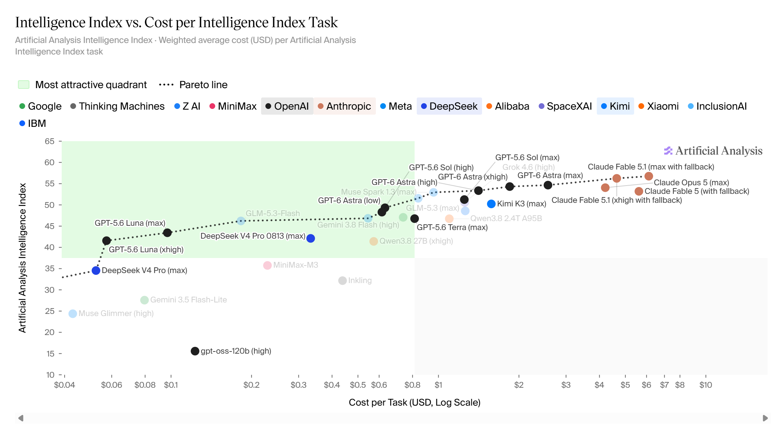
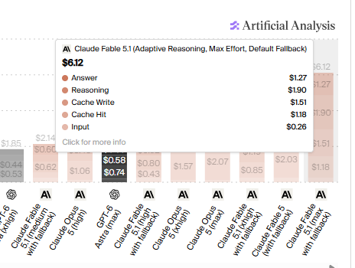
Intelligent Cache Optimization for AI Agents
Literature Review

Slide 6
Intelligent Cache Optimization for AI Agents
Summary of Literature
Key Findings from Literature
Semantic caching significantly reduces repeated LLM calls and inference cost.
Sentence embeddings (SBERT) enable accurate matching of paraphrased queries.
Context-aware caching improves performance in multi-turn conversations.
Existing approaches mainly focus on a single caching strategy (Exact or Semantic).
Most systems lack explainable cache decisions and intelligent cache policies.

Slide 7
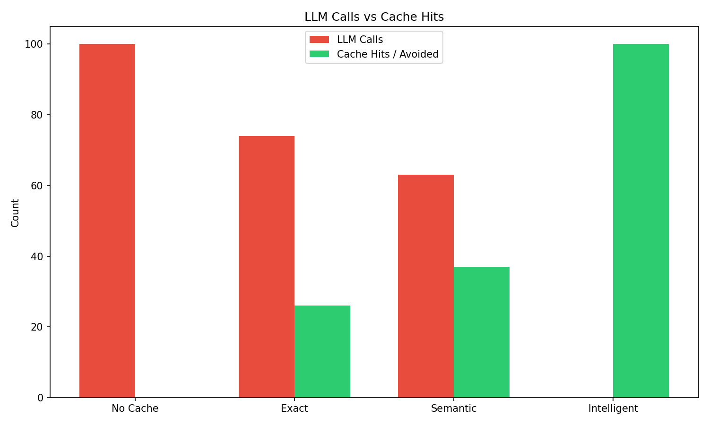
Intelligent Cache Optimization for AI Agents
Additional Information

Slide 8
Intelligent Cache Optimization for AI Agents
Modules to cover
Core Application Layer → API Management
Cache Implementation Layer → Cache Operations
Intelligence Layer → Decision Engine
LLM Provider Layer → Model Connectors
Supporting Components → Utility Services
Dashboard & Monitoring → System Monitoring
Benchmarking Framework → Performance Analysis

Slide 9
Intelligent Cache Optimization for AI Agents
Module name –Cache Manager
Dataset / Query Generation
Generated a custom workload of user queries.
Included exact, paraphrased, contextual, and repeated queries.
Simulated real AI agent interaction patterns.
Cache Validation
Tested Exact Cache for identical queries.
Tested Semantic Cache for similar/paraphrased queries.
Tested Context Cache for multi-turn conversations.
Tested Tool Cache for deterministic tool outputs.

